Slide 1
The Walking Dead
Phoenix Team
Kriti Jar
Ruchika Hazariwal
Harsh Agarwal
Hemaprasanthi Mutyala

Slide 2
Introduction
Presenting you all interactive single player Greenfoot game as the final project for CMPE 202.
The walking Dead is a challenge game for a single played named Daryl, who needs to kill the zombies and cross the levels of game to win the game.
During the game, his score keeps increasing when he grabs food and gets immunity with a first aid kit.
If he collides with zombie, and doesn’t have immunity, he dies, and game is over.

Slide 3
Agile Methodology
Agile methodology was followed during the entire game development process.
We completed the game in 4 sprints of one week each.
It helped us to keep track of our designing and development iterative process and deliver the game on time with all requirements satisfied.

Slide 4
Sprint planning
Sprint 1: We decided game idea and designed the initial UML diagrams that included wireframe diagrams, System Sequence diagram, Activity diagram, Use case diagrams.
Sprint 2: Decided the class diagrams and sequence diagrams and designed initial game that included basic functionalities of all actors.
Sprint 3: Additional functionalities of changing level of game and making it more challenging and updated the designing as we progressed with development.
Sprint 4: Integrated testing and preparations for the final delivery.

Slide 5
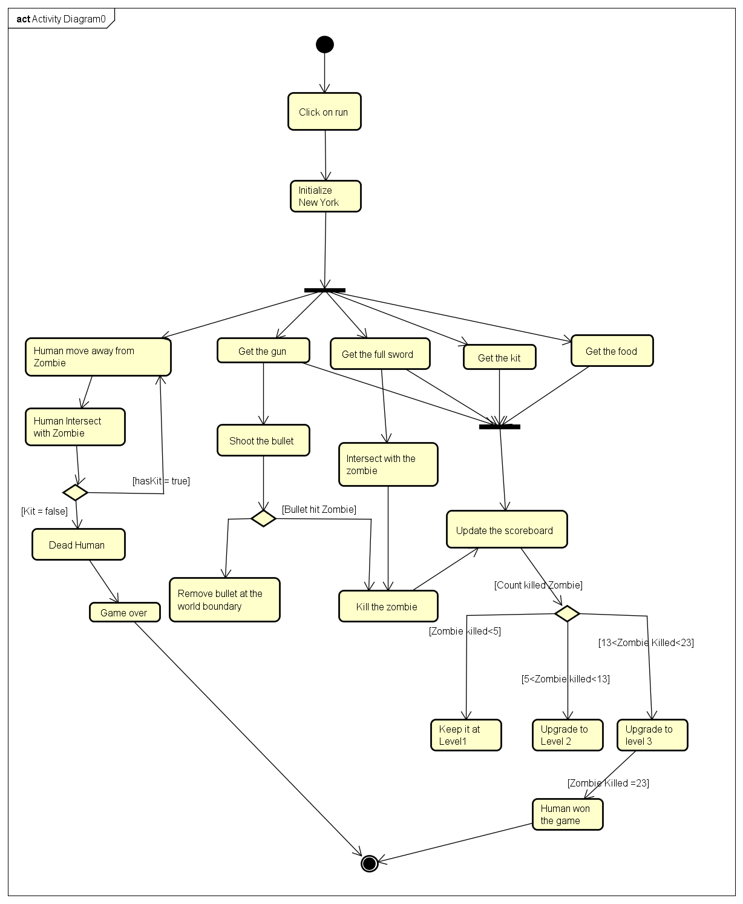
Activity Diagram

Slide 6
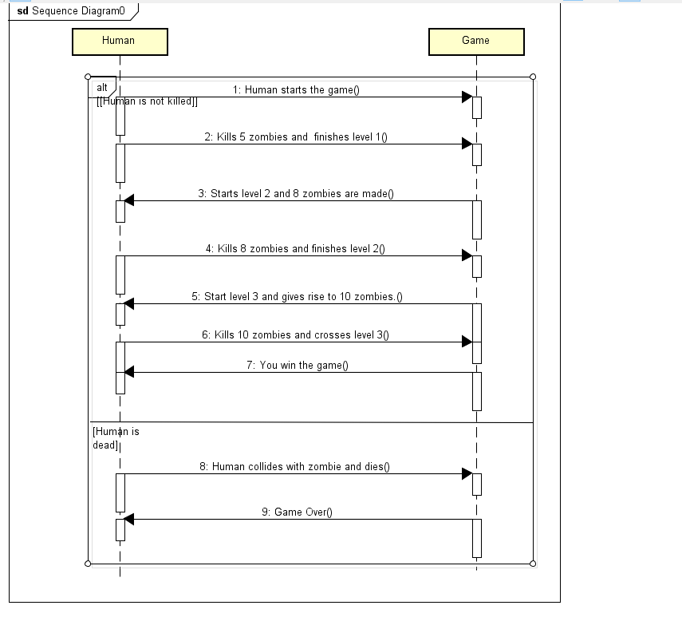
System Sequence Diagram

Slide 7
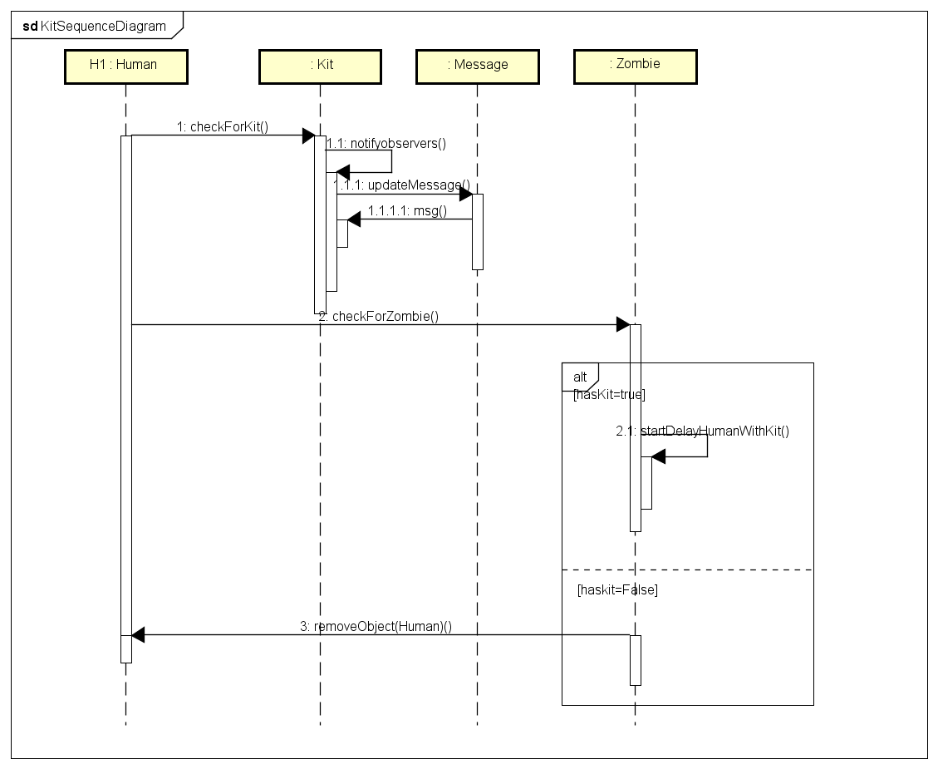
Sequence Diagram for kit

Slide 8
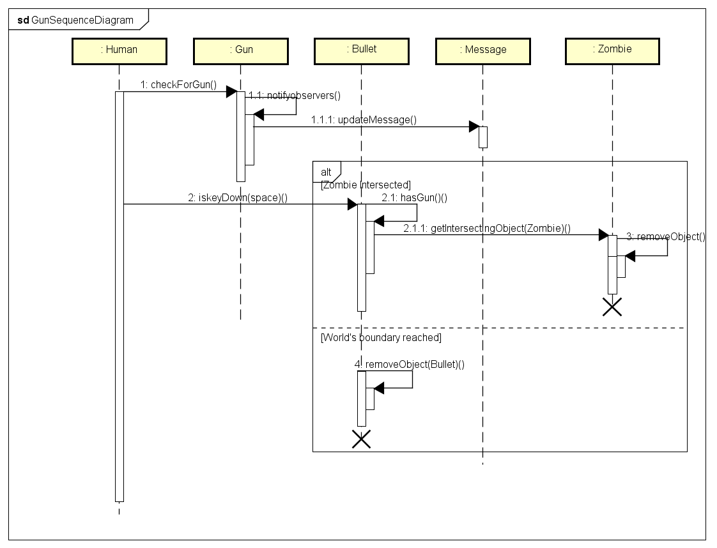
Sequence Diagram for Gun

Slide 9
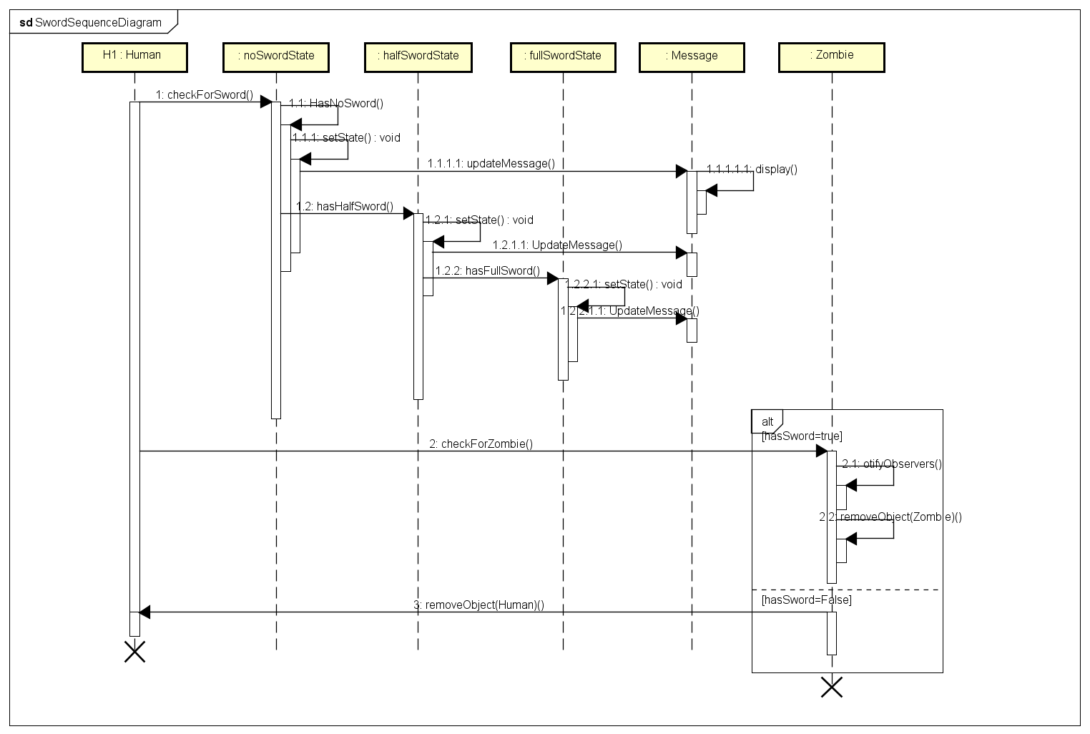
Sequence Diagram for Sword

Slide 10
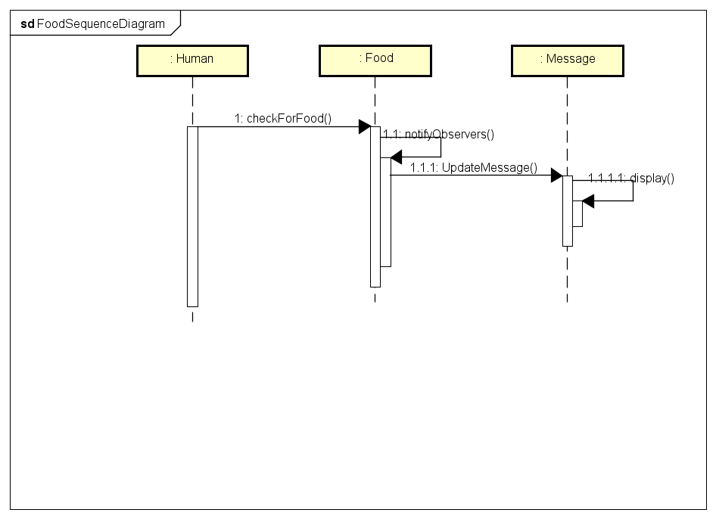
Sequence Diagram for Food

Slide 11
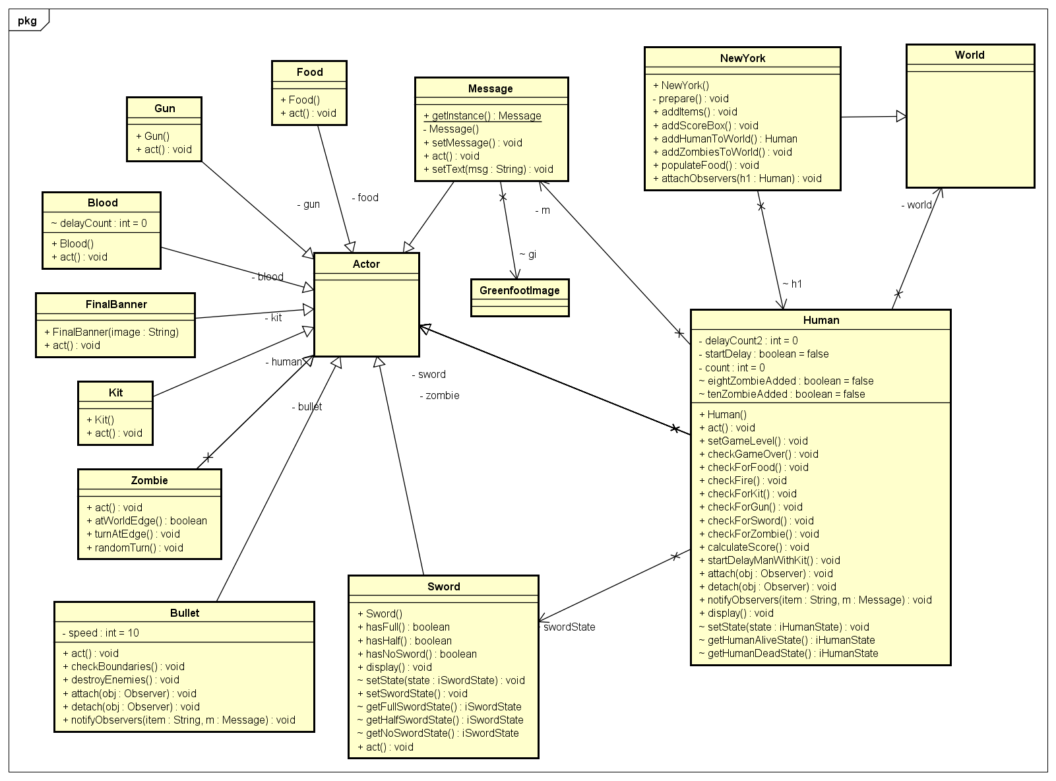
Actors and World class diagram

Slide 12
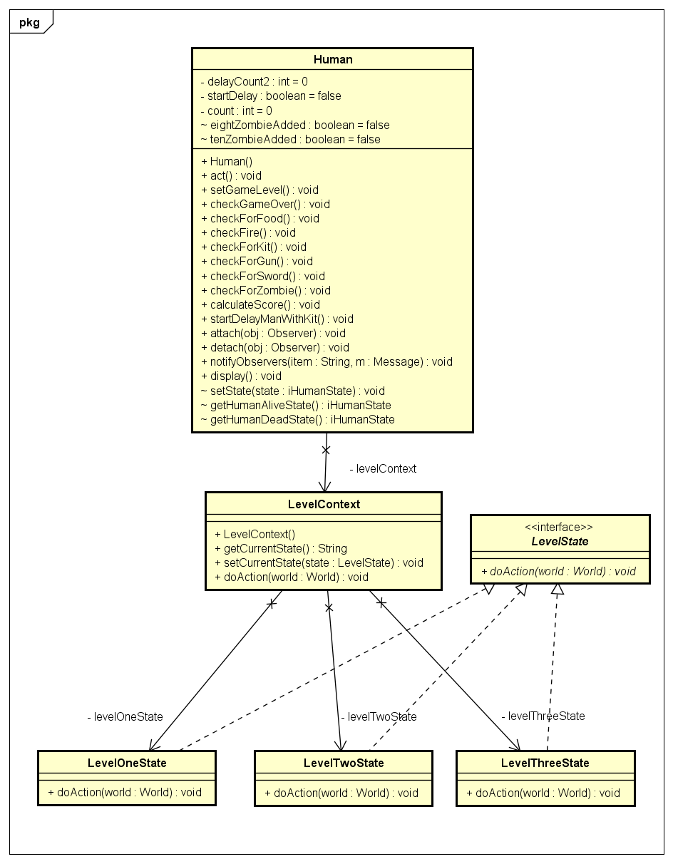
Level State Diagram

Slide 13
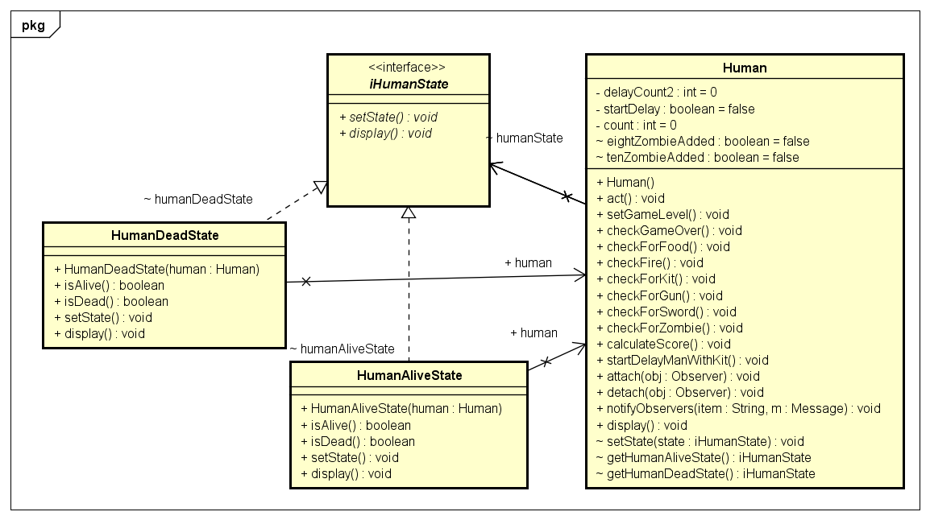
Human State Diagram

Slide 14
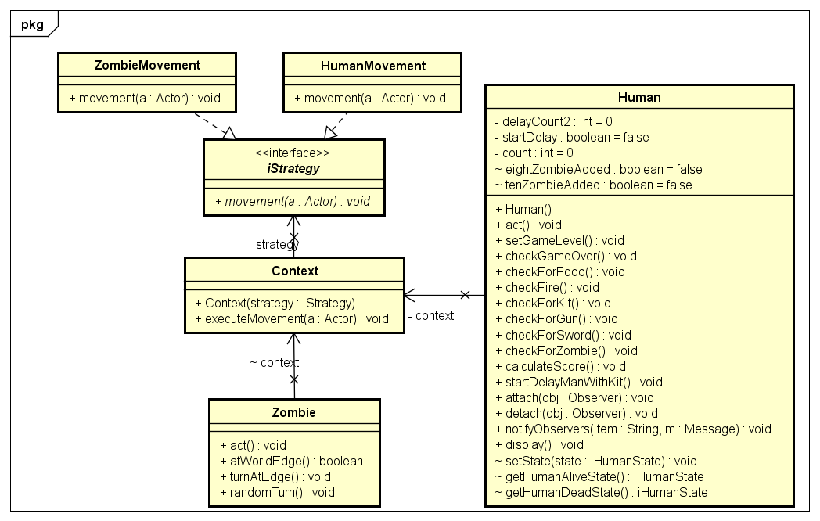
Movement Strategy pattern

Slide 15
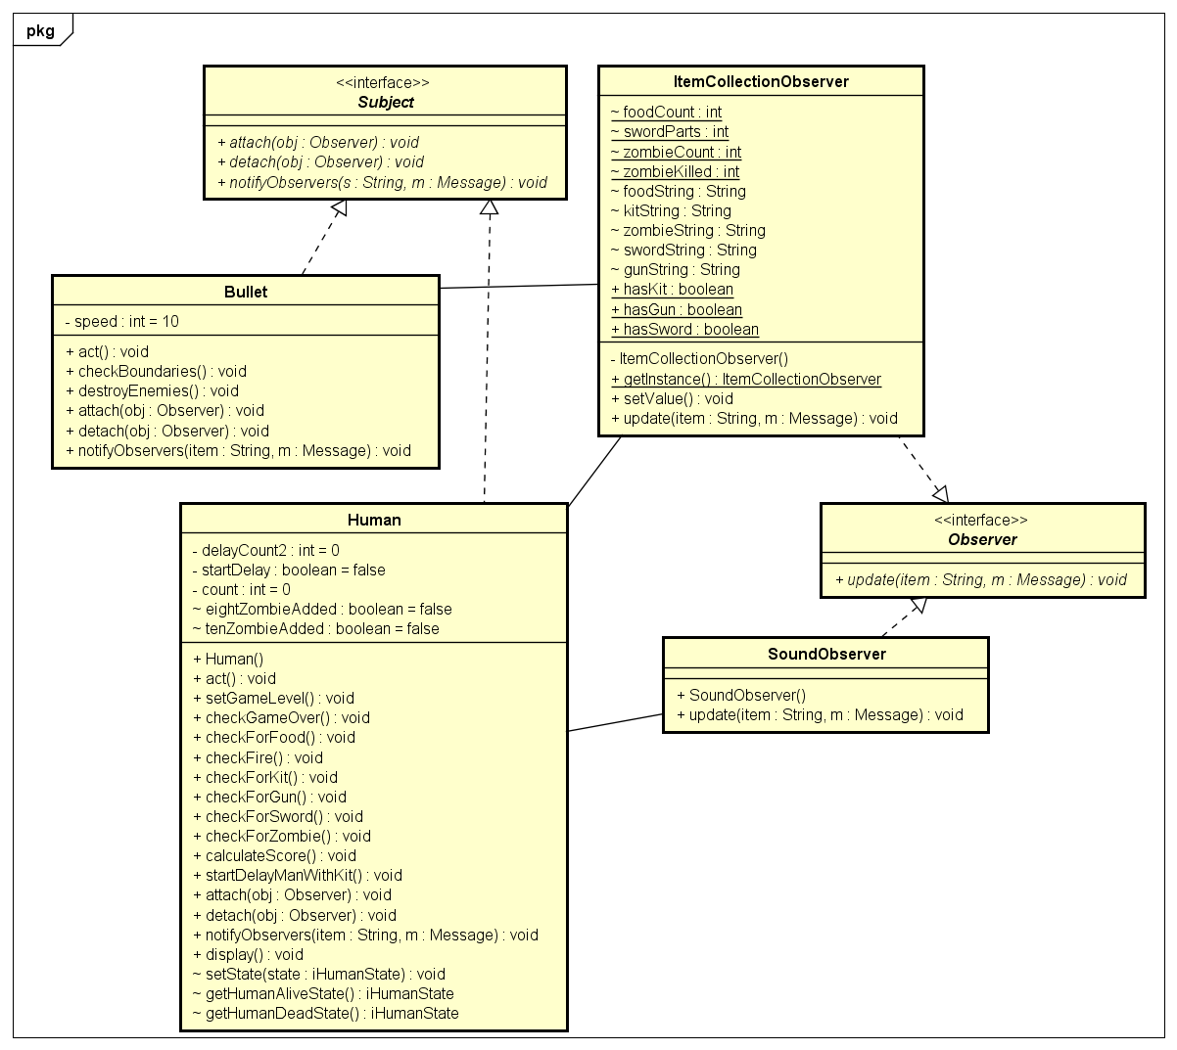
Observer Pattern Diagram

Slide 16
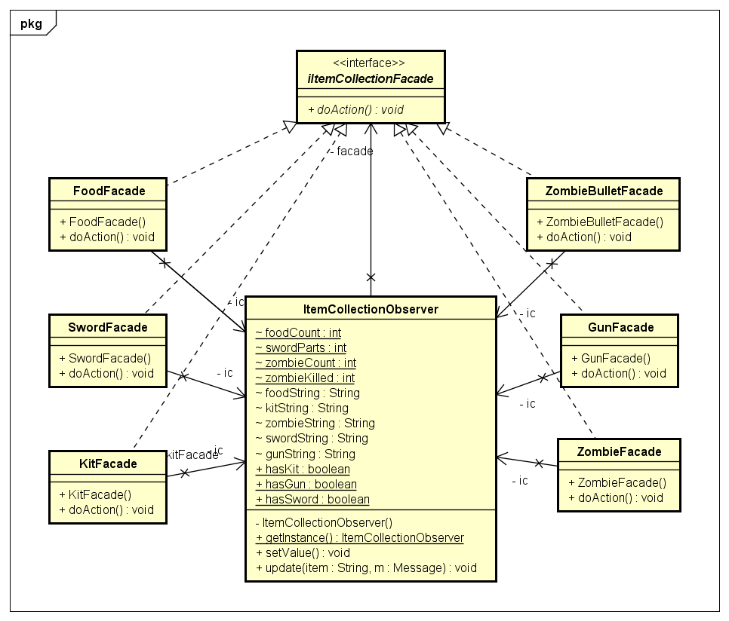
Facade pattern

Slide 17
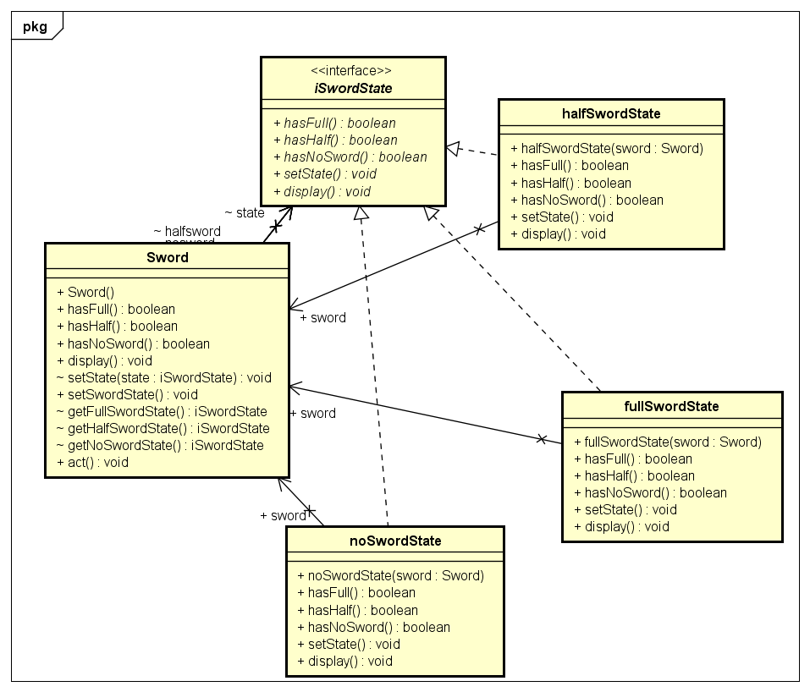
Sword State Pattern

Slide 18
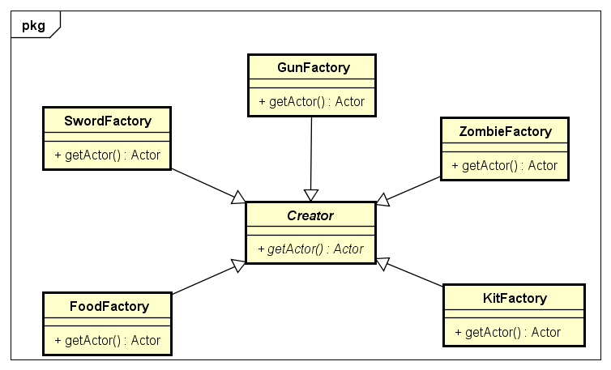
Factory Method pattern

Slide 19
XP Values : Communication
The primary value we focused on during our development was communication
We interacted regularly and had scrum meetings on scheduled time.
We made sure that everyone understands the current status of project and helped each to clear blockers.
During our meetings we took each others feedback positively and worked on them to keep the pace of development going

Slide 20

Questions?

Slide 21
Hope you enjoy the game!!!

